Slide 1
DL classification using MRM data
comparing performance on different combinations of biomarkers
BIBS 인턴 통계학과 최정인

Slide 2
Experimental Design on AACR
Training set (551 obs, 69 markers)
Validation set (137 obs, 69 markers)
AMC dataset (122 obs, 69 markers)
Test Performance
Training set
n=551
Val set
n=137
AMC
n=122
Hyperparameter Tuning

Slide 3
Hyperparameter Tuning of DL on Train/Validation
Activation function : Rectifier / Tanh / Maxout
Input dropout ratio : 0 / 0.05 / 0.1 / 0.2
Epochs : 20 /30 /40 /50 /60 /70 /80 /90 /100 /200 / 300 / 400 / 500 / 600 / 700 / 800
Epsilon : 1e-4 /1e-5 /1e-6 / 1e-7 / 1e-8 / 1e-9 / 1e-10
Train sample per iteration : 0 / -1 / -2
To specify one epoch, enter 0. To specify all available data, enter -1. To use the automatic values, enter -2
2688 combination

Slide 4
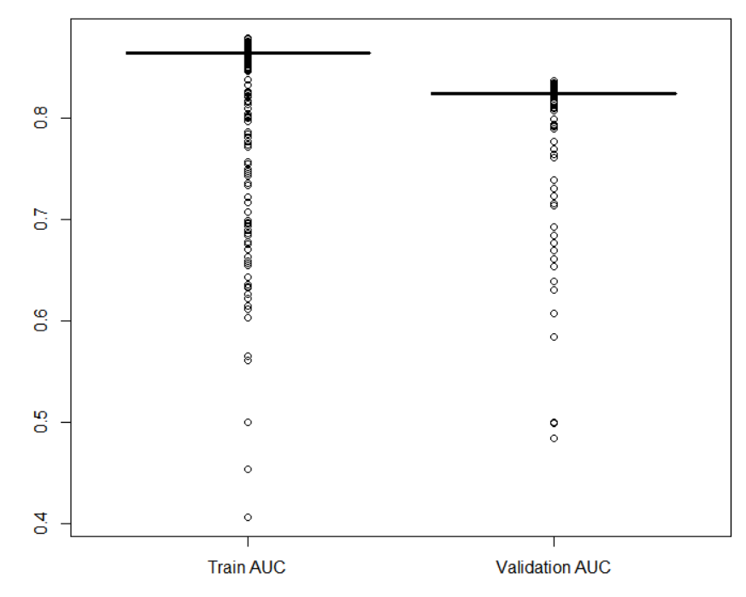
Only CA19-9
Train / Validation AUC in grid search

Slide 5
Only CA19-9
Activation | Input dropout ratio | Epochs | Train samples per iteration | Epsilon | Train AUC | Val AUC
Rectifier | 0.0 | 30 | -1 | 1e-04 | 0.8650 | 0.8365
Rectifier | 0.0 | 70 | -2 | 1e-05 | 0.8720 | 0.8345
Rectifier | 0.3 | 60 | 0 | 1e-04 | 0.8641 | 0.8340
Rectifier | 0.2 | 80 | 0 | 1e-05 | 0.8712 | 0.8337
Rectifier | 0.2 | 500 | -1 | 1e-04 | 0.8681 | 0.8327
Best five models based on validation AUC
Gray : best model

Slide 6
Only CA19-9
 | AUC | Sensitivity (%) | Specificity (%)
Training Set | 0.8650 | 75.48 | 90.69
Validation Set | 0.8365 | 76.92 | 86.11
Independent Test Set (AMC) (model based on Train) | 0.7713 | 70.67 | 80.85
Independent Test Set (AMC) (model based on Train+Valid) | 0.7713 | 70.67 | 80.85
Performance on Train/Validation/AMC set
Performance on AMC is evaluated on models trained in Training set(n=551) and Train+Valid set(n=688)

Slide 7
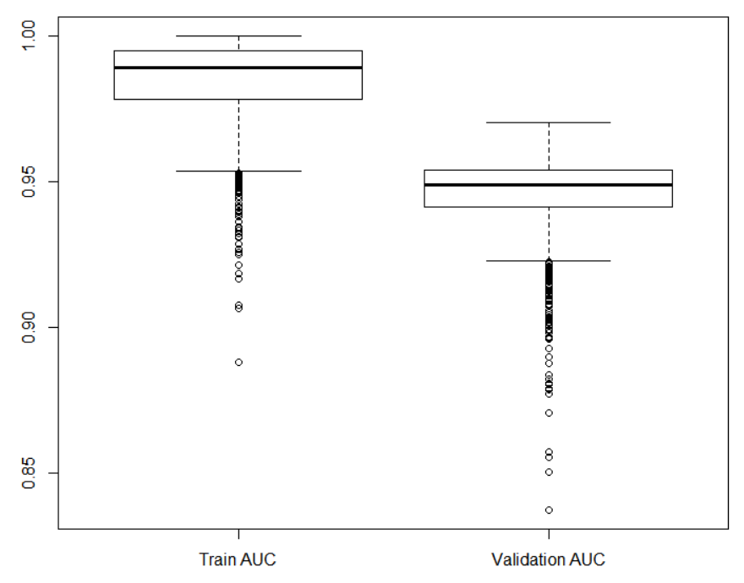
AACR 2021 (14) + CA19-9
Train / Validation AUC in grid search

Slide 8
AACR 2021 (14) + CA19-9
Activation | Input dropout ratio | Epochs | Train samples per iteration | Epsilon | Train AUC | Val AUC
Rectifier | 0.05 | 100 | -1 | 1e-06 | 0.9992 | 0.9682
Rectifier | 0.1 | 700 | 0 | 1e-04 | 0.9940 | 0.9678
Rectifier | 0.2 | 30 | -1 | 1e-05 | 0.9901 | 0.9675
Rectifier | 0.0 | 60 | -2 | 1e-06 | 0.9997 | 0.9673
Rectifier | 0.1 | 200 | 0 | 1e-04 | 0.9924 | 0.9669
Best five models based on validation AUC
Gray : best model

Slide 9
AACR 2021 (14) + CA19-9
 | AUC | Sensitivity (%) | Specificity (%)
Training Set | 0.9992 | 93.10 | 91.03
Validation Set | 0.9682 | 90.77 | 93.06
Independent Test Set (AMC) (model based on Train) | 0.9560 | 97.33 | 78.72
Independent Test Set (AMC) (model based on Train+Valid) | 0.9665 | 96.00 | 85.11
Performance on Train/Validation/AMC set
Performance on AMC is evaluated on models trained in Training set(n=551) and Train+Valid set(n=688)

Slide 10
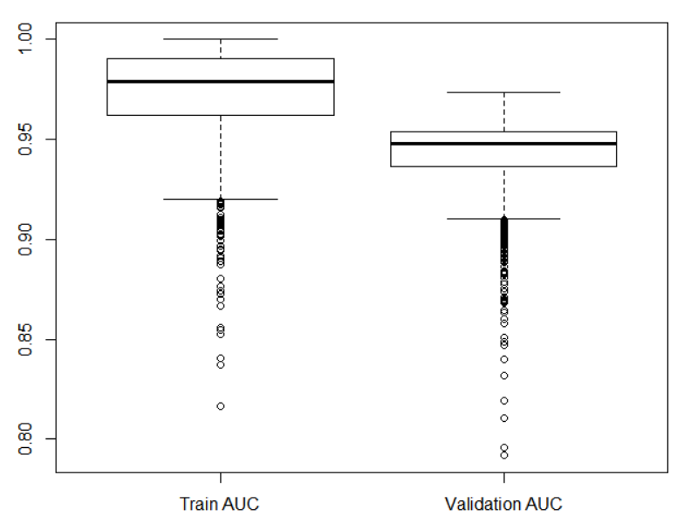
Patent (14) + CA19-9
Train / Validation AUC in grid search

Slide 11
Patent (14) + CA19-9
Activation | Input dropout ratio | Epochs | Train samples per iteration | Epsilon | Train AUC | Val AUC
Rectifier | 0.2 | 400 | 0 | 1e-07 | 0.9951 | 0.9707
Rectifier | 0.0 | 700 | 0 | 1e-08 | 0.9999 | 0.9692
Rectifier | 0.3 | 600 | -1 | 1e-08 | 0.9866 | 0.9684
Rectifier | 0.0 | 800 | -2 | 1e-05 | 0.9986 | 0.9684
Rectifier | 0.3 | 40 | 0 | 1e-06 | 0.9763 | 0.9679
Best five models based on validation AUC
Gray : best model

Slide 12
Patent (14) + CA19-9
 | AUC | Sensitivity (%) | Specificity (%)
Training Set | 0.9951 | 98.47 | 98.62
Validation Set | 0.9707 | 93.85 | 91.67
Independent Test Set (AMC) (model based on Train) | 0.8970 | 92.00 | 72.34
Independent Test Set (AMC) (model based on Train+Valid) | 0.8797 | 84.00 | 78.72
Performance on Train/Validation/AMC set
Performance on AMC is evaluated on models trained in Training set(n=551) and Train+Valid set(n=688)

Slide 13
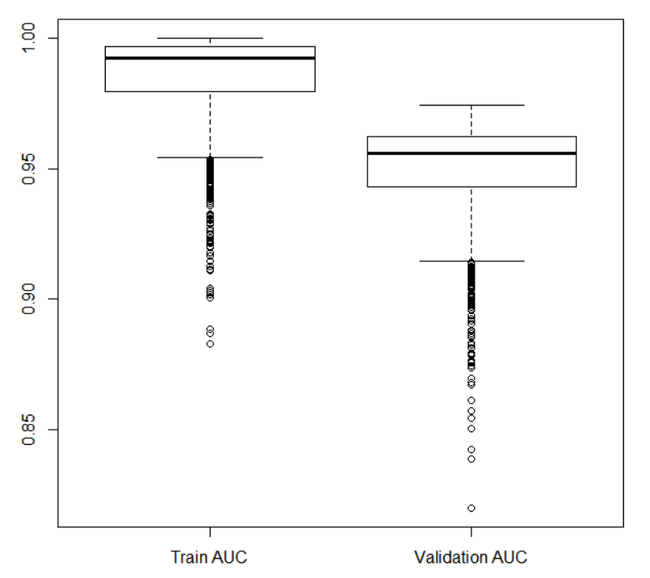
AACR 2021∪Patent (22) + CA19-9
Train / Validation AUC in grid search

Slide 14
AACR 2021∪Patent (22) + CA19-9
Activation | Input dropout ratio | Epochs | Train samples per iteration | Epsilon | Train AUC | Val AUC
Rectifier | 0.0 | 500 | -2 | 1e-04 | 0.9904 | 0.9739
Rectifier | 0.05 | 60 | -1 | 1e-05 | 0.9981 | 0.9735
Rectifier | 0.2 | 200 | -2 | 1e-06 | 0.9959 | 0.9731
Rectifier | 0.05 | 400 | -1 | 1e-07 | 0.9999 | 0.9729
Rectifier | 0.05 | 300 | 0 | 1e-07 | 0.9999 | 0.9722
Best five models based on validation AUC
Gray : best model

Slide 15
AACR 2021∪Patent (22) + CA19-9
 | AUC | Sensitivity (%) | Specificity (%)
Training Set | 0.9904 | 91.95 | 97.59
Validation Set | 0.9739 | 93.85 | 91.67
Independent Test Set (AMC) (model based on Train) | 0.9445 | 92.00 | 78.72
Independent Test Set (AMC) (model based on Train+Valid) | 0.9611 | 92.00 | 82.98
Performance on Train/Validation/AMC set
Performance on AMC is evaluated on models trained in Training set(n=551) and Train+Valid set(n=688)

Slide 16
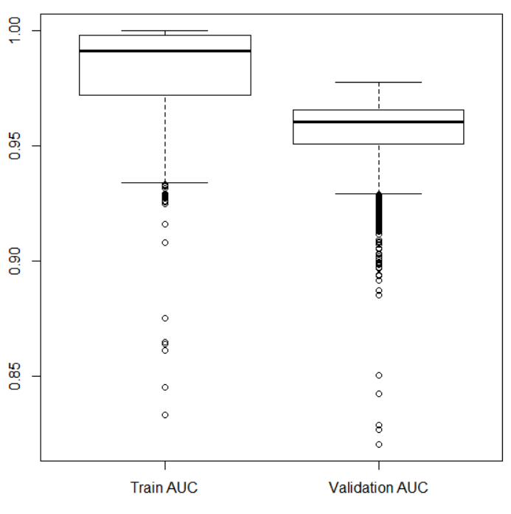
AACR 2021∪Patent (22) + CA19-9
Train / Validation AUC in grid search

Slide 17
AACR 2021∪Patent∪Bertis(29) + CA19-9
Activation | Input dropout ratio | Epochs | Train samples per iteration | Epsilon | Train AUC | Val AUC
Rectifier | 0.05 | 300 | -2 | 1e-07 | 0.9816 | 0.9778
Rectifier | 0.05 | 400 | 0 | 1e-05 | 0.9707 | 0.9771
Rectifier | 0.0 | 400 | -2 | 1e-05 | 0.9993 | 0.9763
Rectifier | 0.05 | 400 | -2 | 1e-06 | 0.9998 | 0.9759
Rectifier | 0.0 | 800 | -2 | 1e-07 | 0.9871 | 0.9750
Best five models based on validation AUC
Gray : best model

Slide 18
AACR 2021∪Patent∪Bertis(29) + CA19-9
 | AUC | Sensitivity (%) | Specificity (%)
Training Set | 0.9816 | 93.10 | 95.52
Validation Set | 0.9778 | 92.31 | 90.28
Independent Test Set (AMC) (model based on Train) | 0.9762 | 96.00 | 87.23
Independent Test Set (AMC) (model based on Train+Valid) | 0.9807 | 97.33 | 91.49
Performance on Train/Validation/AMC set
Performance on AMC is evaluated on models trained in Training set(n=551) and Train+Valid set(n=688)

Slide 19
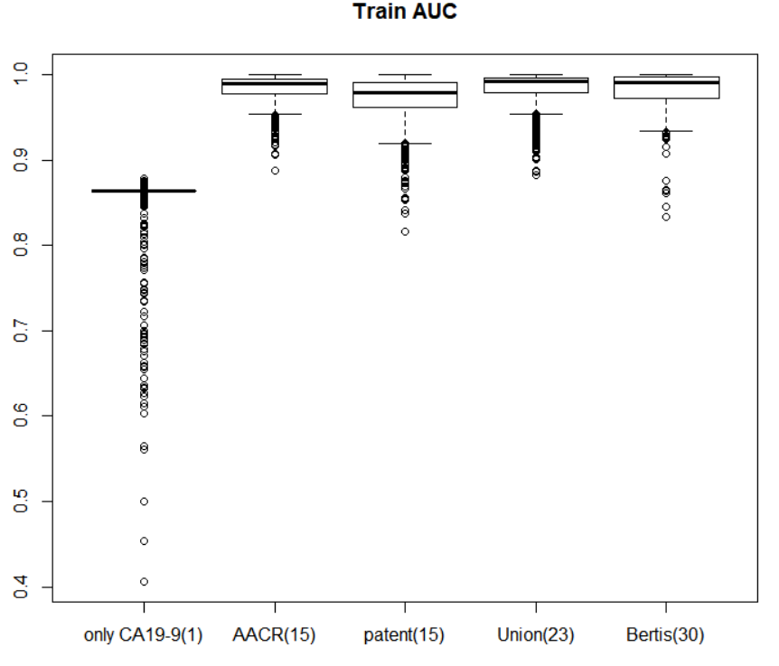
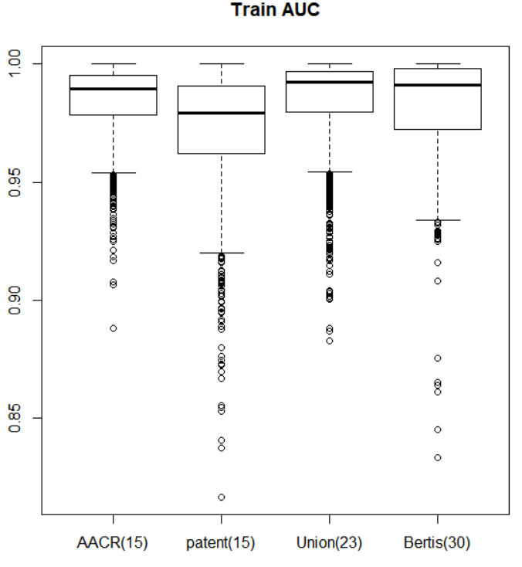
Summary : Train AUC for different combination of biomarkers

Slide 20
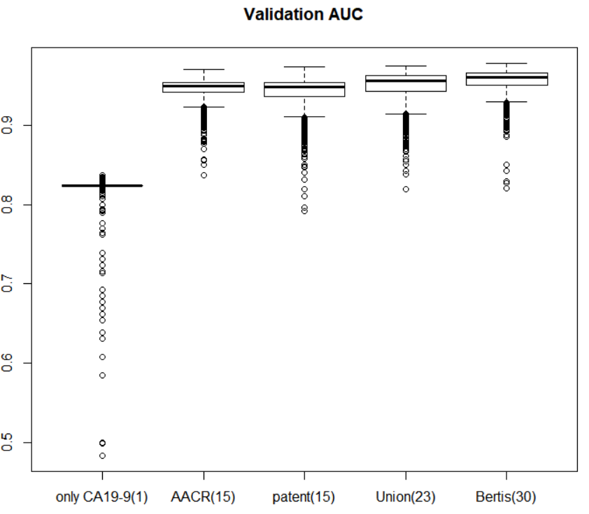
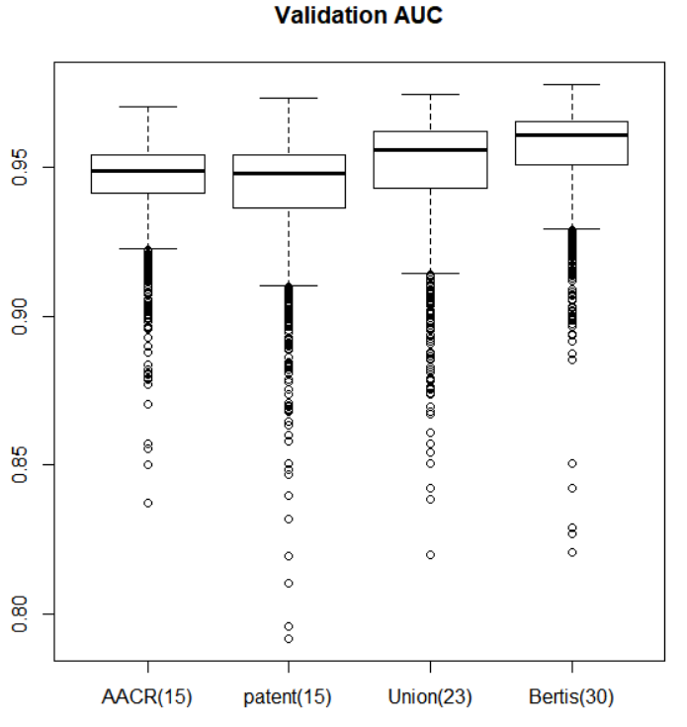
Summary : Validation AUC for different combination of biomarkers

Slide 21
Summary : Train/Valid/Indep AUC for different combination of biomarkers
 | Train AUC | Validation AUC | Independent Set(AMC) AUC
AACR 2021 | 0.989 | 0.972 | 0.952
Only CA19-9 | 0.8650 | 0.8365 | 0.7713
AACR(14)+CA19-9 | 0.9992 | 0.9682 | 0.9560
Patent(14)+CA19-9 | 0.9951 | 0.9707 | 0.8970
AACR∪Patent (22)+CA19-9 | 0.9904 | 0.9739 | 0.9445
AACR∪Patent∪Bertis(29)+CA19-9 | 0.9816 | 0.9778 | 0.9762
Gray: results of AACR(2021) which used 14 biomarkers + CA19-9
based on LASSO regression

